Slide 1
DNA fountain enables a robust and efficient storage architecture
-Yaniv Erlich and Dina Zielinski
New York Genome Center, New York, NY 10013, USA
Presented BY:
Samarth Desai
201301456

Slide 2
Why DNA for storage?
Humanity is currently producing data at exponential rates, creating a demand for better storage devices. DNA is an excellent medium for data storage with demonstrated information density of petabytes of data per gram.
Also DNA is highly durable and can evoltionalize and optimize the machinery we are using today. Also recent study and experiments have demonstrated the value of DNA as a storage medium.

Slide 3
How practical is the use of DNA?
To understand the potential of DNA storage they explored the Shannon Information Capacity. This measure sets a tight upper bound on the amount of information that can be reliably stored in each nucleotide.The theoretical max. we can store is 2 bits.
However DNA encoding faces several practical limitations.Mainly Biochemical constrains and Oligo synthesis problems. (oligo is short for Oligonucleotides)

Slide 4
Biochemical Constraints
It dictates that a DNA sequence with high GC content or long homopolymer runs (e.g. AAAAAA…) should be avoided as they are difficult to synthesize and prone to sequencing errors.
Quantitative analysis shows that the biochemical constraints reduce the storage potential of each nucleotide to 1.98bits from 2bits.

Slide 5
Oligo synthesis problems and Dropouts
In addition to biochemical constraints, oligos are sequenced in a pool and necessitate indexing to infer their order, which further limits the number of available nucleotides for encoding information.
Also PCR amplification and decay of DNA during storage can induce uneven representation of the oligos. After combining the expected dropout rates and barcoding demand, the overall Shannon information capacity of a DNA storage device is around 1.83bits per nucleotide for a range of practical architectures.

Slide 6
Furhter Limitations
Previous studies of DNA storage realized about half of the Shannon information capacity of DNA molecules and in some cases reported challenges to perfectly retrieve the information.
E.G.:- two previous studies attempted to address oligo dropout by dividing the original file into overlapping segments so that each input bit is represented by multiple oligos. However, this repetitive coding procedure generates a loss of information content and is poorly scalable.

Slide 7
Continued..
Other studies explored the usage of Reed-Solomon (RS) code on small blocks of the input data in order to recover dropouts. While these studies were able to perfectly retrieve the data, they were still far from realizing the capacity.
Moreover, testing this strategy on a large file size highlighted difficulties in decoding the data due to local correlations and large variations in the dropout rates within each protected block.

Slide 8
DNA Fountain is developed
Taken together, these results inspired them to seek a coding strategy that can better utilize the information capacity of DNA storage devices while showing higher data retrieval reliability.
They devised a strategy for DNA storage devices, called DNA Fountain, that approaches the Shannon capacity(1.83 b/nt) while providing strong robustness against data corruption.

Slide 9
DNA Fountain
This strategy harnesses fountain codes which allows reliable and effective unicasting of information over channels that are subject to dropouts e.g. mobile TV.
In their design, they carefully adapted the power of fountain codes to overcome both oligo dropouts and the biochemical constraints of DNA storage. The encoder works in three steps 1)Preprocessing 2)Luby Transform 3)Screening

Slide 10
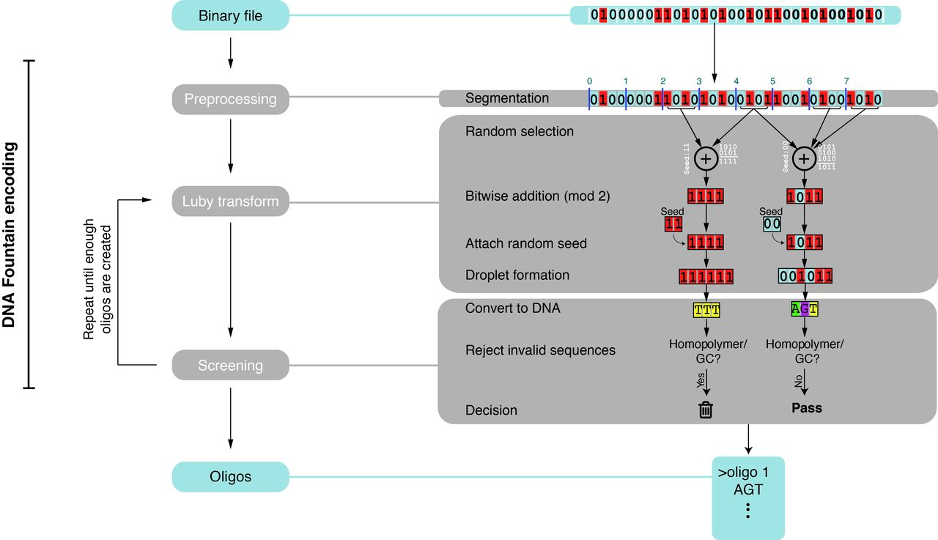
Encoding in DNA Fountain

Slide 11
Preprocessing
In the preprocessing step, they start by packaging the files of interest into a single tape-archive (tar) file, which is than compressed using a standard lossless algorithm (e.g. gzip). Besides the obvious advantage of reducing the size of the tar file, compression increases the entropy of each bit of the input file and reduces local correlations, which is important for the screening step.
Then, the algorithm logically partitions the compressed file into non-overlapping segments of length L bits, which is a user defined parameter. They used L = 256bits (32 bytes) for their experiments.

Slide 12
2) Luby Transform
Next, it iterates over two computational steps: Luby Transform and screening. The Luby Transform sets the basis for fountain codes. Basically, it packages data into any desired number of short messages, called droplets, by selecting a random subset of segments from the file using a special distribution and adding them bitwise together under a binary field.
The droplet contains two pieces of information: a data payload part that holds the result of the addition procedure and a short, fixed-length seed.

Slide 13
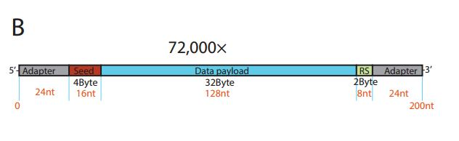

Slide 14
Contd..
This seed corresponds to the state of the random number generator of the transform during the droplet creation and allows the decoder algorithm to infer the identities of the segments in the droplet.
Theoretically, reversing the Luby Transform to recover the file is possible using a highly efficient algorithm by collecting any subset of droplets as long as the accumulated size of droplets is slightly bigger than the size of the original file.
We apply one round of the transform in each iteration to create a single droplet. Next, the algorithm moves to the droplet screening stage.

Slide 15
3) Screening
In screening, the algorithm translates the binary droplet to a DNA sequence by converting {00,01,10,11} to {A,C,G,T}, respectively. Then, it screens the sequence for the desired biochemical properties of GC content and homopolymer runs.
If the sequence passes the screen, it is considered valid and added to the oligo design file; otherwise, the algorithm simply trashes the droplet. Since the Luby Transform can create any desired number of droplets, we keep iterating over the droplet creation and screening steps until a sufficient number of valid oligos are generated. In practice, we recommend 5%-10% more oligos than input segments

Slide 16
Decoding from DNA
First they retained the sequences whose length was still 152nt.Then they removed the identical sequences from the data and lastly sorted the sequences based on their abundance so that more prevalent sequences appear first.
This way the decoder observes the highest quality data first and gradually gets sequences with reduced quality. Due to the redundancy of the approach, the decoder usually does not need all oligos to construct the original file and will usually stop before attempting to decode sequences that were observed a small number of times.

Slide 17
Contd..
From this point the decoder process works sequentially and executes the next two steps on each collapsed sequence until the file is fully resolved: 1)Droplet Recovery 2)Segment Inference

Slide 18
Droplet Recovery
The decoder maps the DNA sequence into a binary format by translating {A,C,G,T}, to {0, 1, 2, 3}. Next, it parses the sequence read to extract the seed, data payload and the error correcting code.The decoder checks whether there are any errors.
In their experiments, they found that most errors were due to short insertions and deletions, potentially from the oligo synthesis. ReedSolomon error correcting code can only handle substitutions and attempting to correct the sequence is more likely to result in erroneous recovery.

Slide 19
Segment Inference
After validating the integrity of the binary message, the decoder initializes a pseudorandom number generator with the observed seed. This generates a list of input segment identifiers.
Next, it employs one round of a message passing algorithm, which works as follows: first, if the droplet contains segments that were already inferred, the algorithm will XOR these segments from the droplet and remove them from the identity list of the droplet.

Slide 20
Contd..
Second, if the droplet has only one segment left in the list, the algorithm will set the segment to the droplet’s data payload. Next, the algorithm will propagate the information about the new inferred segment to all previous droplets and will repeat the same procedure recursively, until no more updates can be made.
If the file is not recovered, the decoder will move to the next sequence in the file and execute the droplet recovery and segment inference steps. This process of propagation of information eventually escalates that solves the entire file.

Slide 21
Time Complexity and cost of encoding and decoding
Their experiments show that DNA Fountain is feasible for a range of file sizes and oligo lengths.our encoding strategy scales log-linearly with the input file size and empirical tests showed that a 50Mbyte file takes about 1 hour on a single CPU of a standard laptop.
On the other hand, the complexity scales exponentially with the oligo length because it becomes harder to find sequences without homopolymers and increasing numbers of droplets are created only to be destroyed in the screening process.

Slide 22
Contd..
With the current price of $0.5 for one hour of a 40 CPU server on Amazon Web Services, we can encode the entire input data of 1 GB for $1.25 in a few hours.The price of the computing time is substantially smaller than the cost reduction in the oligo synthesis costs.
Assuming that oligo synthesis is $640 per 1Mb synthesizing 1Gbyte with our scheme would cost approximately $3.27 million. However, when using other methods with lower information content of 0.9bit/nt, the synthesis price is nearly $5.63 million, rendering the computational costs marginals compared to price.

Slide 23
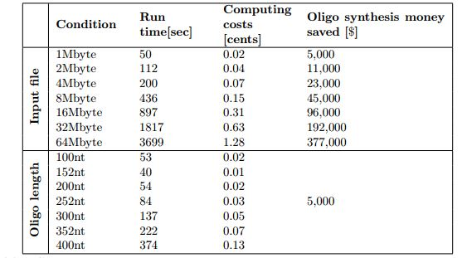
DNA Fountain’s experiment data(Cost Effeciency)

Slide 24
An Experiment
We used DNA Fountain to encode a single compressed file of 2,146,816 bytes in a DNA oligo pool.
We split the input tarball into 67,088 segments of 32bytes and iterated over the steps of DNA Fountain to create valid oligos
Each droplet was 38bytes (304bits): 4bytes of the random number generator seed, 32bytes for the data payload, and 2bytes for a Reed-Solomon error correcting code, to reject erroneous oligos in low coverage conditions
The DNA oligos had a length of (304/2)=152nt and were screened for homopolymer runs of ≤3nt and GC content of 45%-55%.

Slide 25
Contd..
We instructed DNA Fountain to generate 72,000 oligos, yielding a redundancy of (72,000/67,088-1)=7%. We selected this number of oligos due to the price structure offered by the manufacturer, allowing us to maximize the number of oligos per dollar.
Encoding took 2.5min on a single CPU of a standard laptop. Importantly, we achieved an information density of 1.57bit/nt, only 14% from the Shannon capacity of DNA storage(1.83b/nt) and 60% more than previous studies with a similar scale of data.

Slide 26
Contd..
Sequencing and decoding the oligo pool fully recovered the entire input file with zero errors.
decoding took approximately 9min with a Python script on a single CPU of a standard laptop.
The decoder recovered the information with 100% accuracy after observing only 69,870 oligos out of the 72,000 in our library.
These results indicate that beyond its high information density, DNA Fountain also reduces the amount of sequencing required for data retrieval, which is beneficial when storing large-scale information.

Slide 27
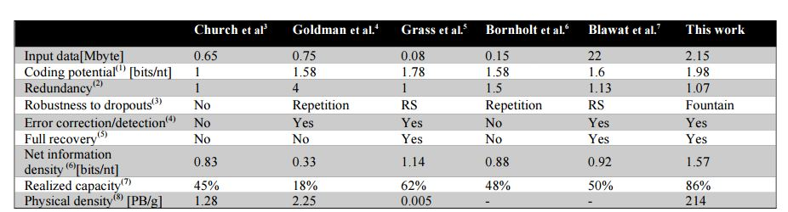
Comparision with other meathods

Slide 28
Thank You

